Slide 1
POWER POINT CHEMICALS
Presented by
Name:
Date :

Slide 2
INTRODUCTION
The chemicals chosen in this case are chromium and Pentachlorophenol.
Chemical from Target Compound List: Chromium.
Chemical from Safe Drinking Water Act List: Pentachlorophenol.
The structural, chemical properties, effects and their applications will be presented.

Slide 3
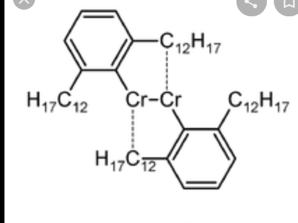
Chromium chemical element.
Chemical element with symbol Cr , atomic number 24, group 6.
Steel grey, hard and brittle transition metal.
It produces smooth and silver finish resistant to corrosion hence used as stainless steel.
Majorly used as a catalyst in dyeing and tanning of lather.
Chromium is unstable in oxygen, on exposure to oxygen it produces an oxide layer impermeable to oxygen hence protecting metal below (Zoroddu, 2019).

Slide 4
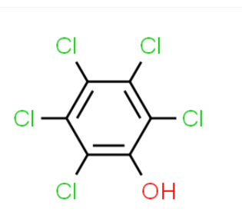
Pentachlorophenol.
The molecular formula : C₆HCl₅O a conjugate acid of Pentachlorophenolate
and a member of pentachlorobenze an aromatic fungicide.
It is slightly soluble in water and is noncombustible.
Used for treating and preserving wood because of its broad spectrum of activity against fungi and insects (Marino,2015).
It provides long term protection though it is being forbidden due high toxicity.

Slide 5
Existence and Effects of the two chemicals
Chromium levels is high in soil but low in water and air .
It exists has chromium (iii) and chromium (iv).
Exposure to chromium causes respiratory problems, weakens immune system, skin rashes and lung cancer.
Pentachlorophenol does not exist naturally, it is manufactured.
Pure Pentachlorophenol exists as colorless crystals , impure ones exists as dust, beads or flakes (Seiler, 2015)
Pentachlorophenol is extremely toxic on inhaling, injecting or coming in direct contact.

Slide 6
Reference
Zoroddu, M. A., Aaseth, J., Crisponi, G., Medici, S., Peana, M., & Nurchi, V. M. (2019). The essential metals for humans: a brief overview. Journal of inorganic biochemistry.
Seiler, J. P. (2015). Pentachlorophenol. Mutation Research/Reviews in Genetic Toxicology, 257(1), 27-47.
Marino, S. (2015). A study of a well water testing program: The actions of privatewell owners. Southern Connecticut State University.

